Slide 1
Basic presentation

Slide 2
Agenda
CI/CD A Gentle Introduction
Cloud Basics
Configuration Management
Deployment Strategies
What is Devops
Infra as a code
Linux

Slide 3
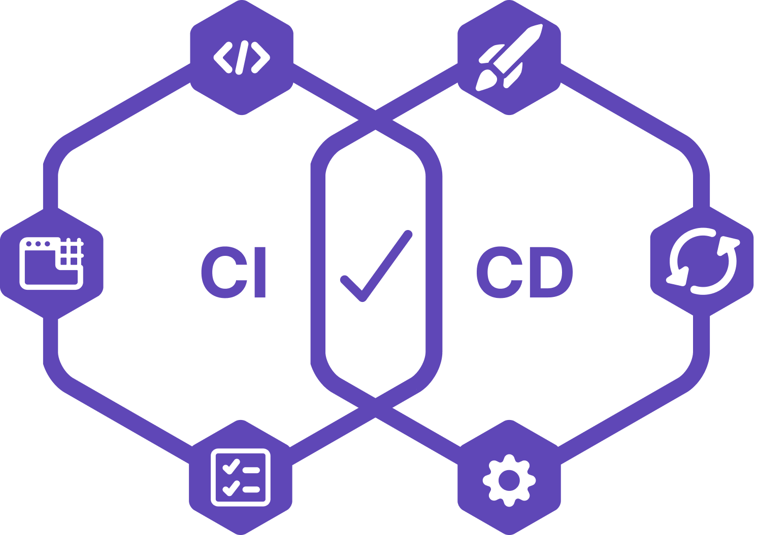
CI / CD Introduction

Slide 4
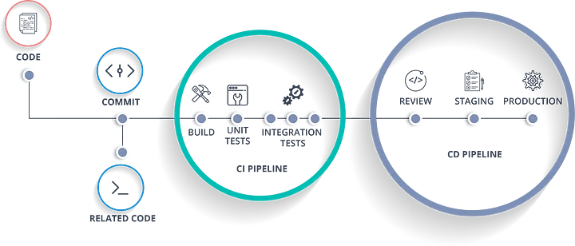
Engaging the audience
CI/CD, which stands for continuous integration and continuous delivery/deployment, aims to streamline and accelerate the software development lifecycle.
Continuous Integration (CI) refers to the practice of automatically and frequently integrating code changes into a shared source code repository. Continuous Delivery and/or deployment (CD) is a 2 part process that refers to the integration, testing, and delivery of code changes. Continuous delivery stops short of automatic production deployment, while continuous deployment automatically releases the updates into the production environment.
Taken together, these connected practices are often referred to as a CI/CD pipeline and are supported by development and operations teams working together in an agile way with either a DevOps or site reliability engineering (SRE) approach.

Slide 5
Configuration Management
Definition : Configuration Management is a practice of systematically managing and maintaining the configuration of software systems and infrastructure components throughout their lifecycle. It involves processes, tools, and techniques to track, control, and manage configurations.
Purpose: Configuration Management aims to ensure consistency, reliability, and traceability of system configurations. It involves managing software versions, configurations, dependencies, and their relationships. Configuration Management ensures that systems are correctly configured, changes are controlled, and configurations can be reproduced or rolled back.
Scope: Configuration Management covers the management of software configurations, including applications, middleware, databases, and related components. It includes version control, release management, change control, and auditing of configurations.
Tools: Popular Configuration Management tools include Ansible, Puppet, Chef, SaltStack, and Microsoft PowerShell DSC. These tools provide capabilities to define and manage software configurations, enforce desired states, and automate configuration tasks.

Slide 6
Navigating Q&A sessions
Know your material in advance
Anticipate common questions
Rehearse your responses
Maintaining composure during the Q&A session is essential for projecting confidence and authority. Consider the following tips for staying composed:
Stay calm
Actively listen
Pause and reflect
Maintain eye contact

Slide 7
Selecting visual aids
Enhancing your presentation

Slide 8
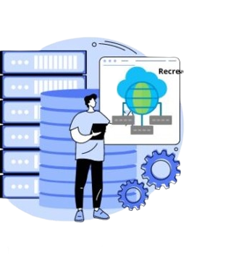
Deployment Strategies

Slide 9
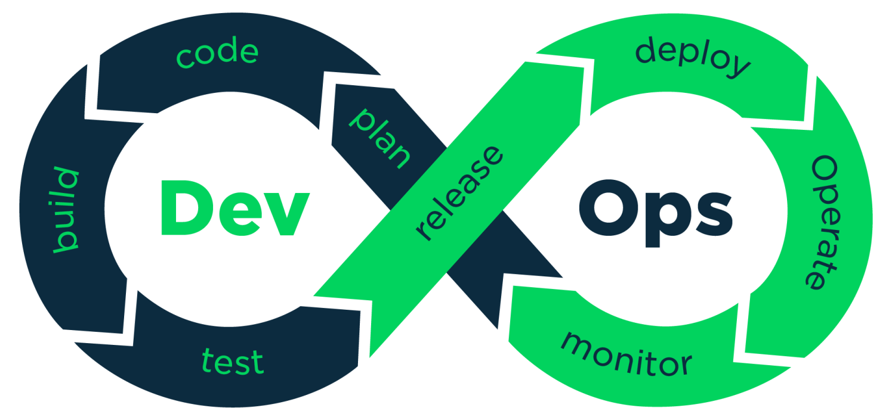

What is DevOps

Slide 10
Infra as a Code

Slide 11
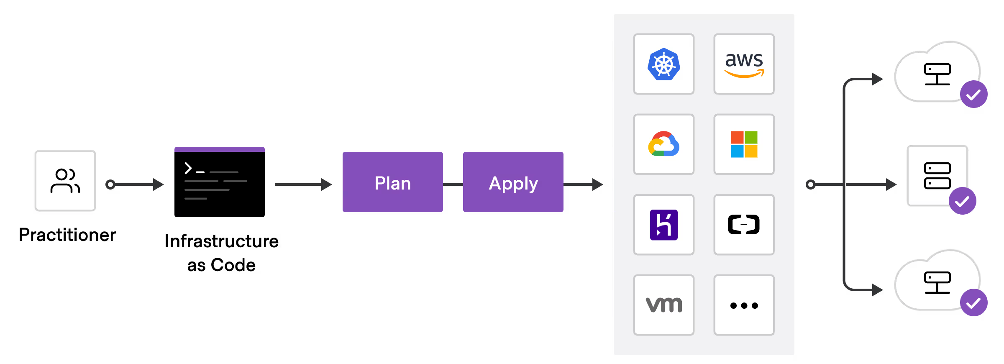



If you use code to provision and configure the infrastructure, it is called Infrastructure as code (IaC). To put it simply, codifying the infrastructure provisioning and configuration.
With the concept of Infrastructure as code, you can follow the same workflow you use for application development for Infrastructure as code development. Meaning, versioning the infrastructure code in git, running unit tests, and integration tests, and then deploying it
Benefits of IaC
Following are some of the key benefits of IaC
With IaC, you can recreate any complex infrastructure with one click.
You can version control your infrastructure state in the form of IaC.
Developer-centric workflow in infrastructure management. Like developing applications, a standard practice for IaaC is to follow all standard coding practices like testing, review, etc. Many companies follow test-driven IAC developed to have fool proof infra-change systems.

Slide 12

Linux

Slide 13
What is Linux

Slide 14
Speaking engagement metrics
Impact factor | Measurement | Target | Achieved
Audience interaction | Percentage (%) | 85 | 88
Knowledge retention | Percentage (%) | 75 | 80
Post-presentation surveys | Average rating | 4.2 | 4.5
Referral rate | Percentage (%) | 10 | 12
Collaboration opportunities | # of opportunities | 8 | 10

Slide 15
Thank you
Brita Tamm
502-555-0152
brita@firstupconsultants.com
www.firstupconsultants.com

